Slide 1
Course Agenda
Use SQL Developer and other available SQL interfaces
Write simple and complex SQL queries using various join techniques and format & sort the data as needed
Supplement SQL code with references to pseudo columns and system functions
Summarize, group, and combine data to obtain more meaningful query results
Draw conclusions and make business decisions based upon the data processed
Create and maintain database tables using the SQL Data Definition Language (DDL)
Manage data within tables using the SQL Data Manipulation Language (DML)
Use the powerful set of built-in SQL functions

Slide 2
Session 1: Introduction to DBMS

Slide 3

What is Database
The database is a collection of inter-related data which is used to retrieve, insert and delete the data efficiently. It is also used to organize the data in the form of a table, schema, views, and reports, etc.
For example: The college Database organizes the data about the admin, staff, students and faculty etc.
Using the database, you can easily retrieve, insert, and delete the information.

Slide 4

Database Management System
Database management system is a software which is used to manage the database. For example: MySQL, Oracle, etc. are a very popular commercial database which is used in different applications.
DBMS provides an interface to perform various operations like database creation, storing data in it, updating data, creating a table in the database and a lot more.
It provides protection and security to the database. In the case of multiple users, it also maintains data consistency.

Slide 5
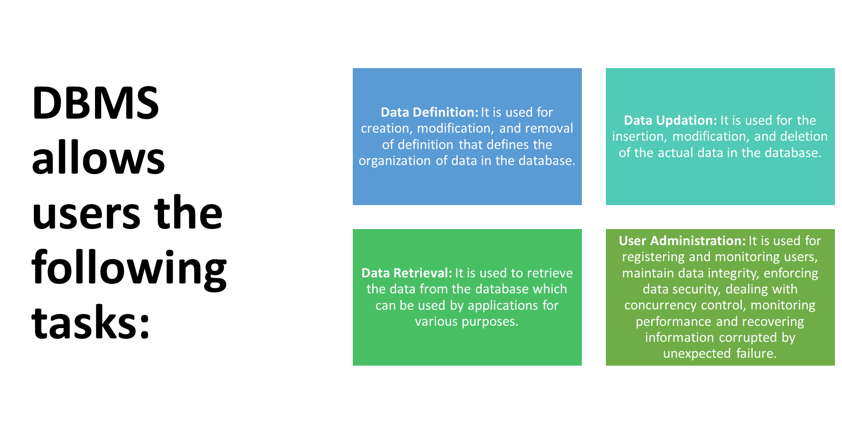

Slide 6
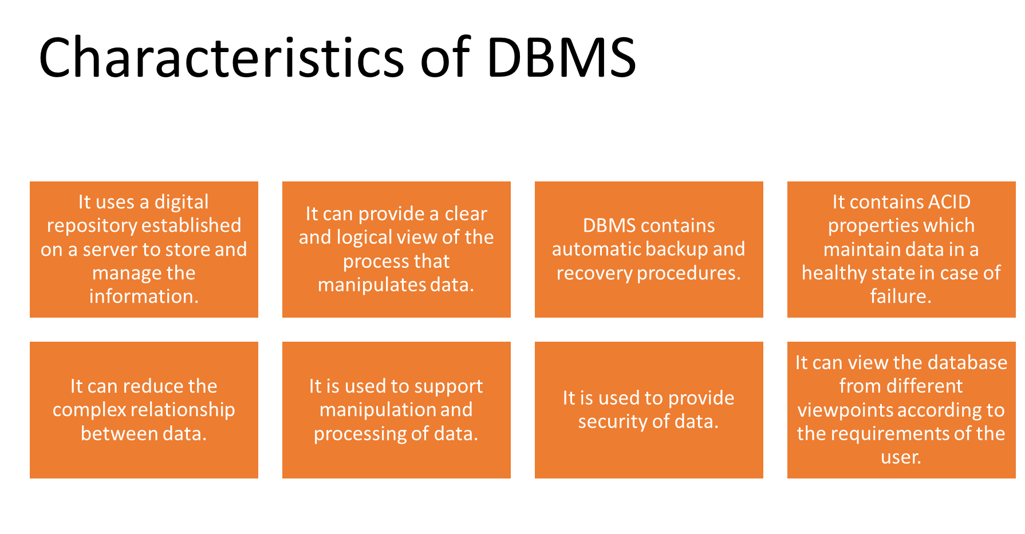

Slide 7
Advantages of DBMS
Controls database redundancy: It can control data redundancy because it stores all the data in one single database file and that recorded data is placed in the database.
Data sharing: In DBMS, the authorized users of an organization can share the data among multiple users.
Easily Maintenance: It can be easily maintainable due to the centralized nature of the database system.
Reduce time: It reduces development time and maintenance need.
Backup: It provides backup and recovery subsystems which create automatic backup of data from hardware and software failures and restores the data if required.
multiple user interface: It provides different types of user interfaces like graphical user interfaces, application program interfaces

Slide 8
Disadvantages of DBMS
Cost of Hardware and Software: It requires a high speed of data processor and large memory size to run DBMS software.
Size: It occupies a large space of disks and large memory to run them efficiently.
Complexity: Database system creates additional complexity and requirements.
Higher impact of failure: Failure is highly impacted the database because in most of the organization, all the data stored in a single database and if the database is damaged due to electric failure or database corruption then the data may be lost forever.

Slide 9
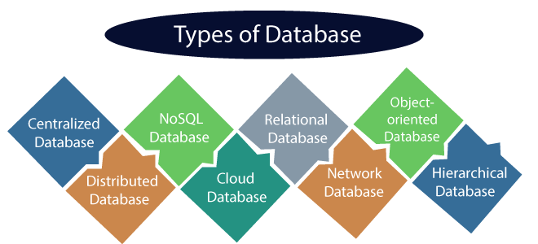
Types of Databases
There are various types of databases used for storing different varieties of data:

Slide 10

Centralized Database
It is the type of database that stores data at a centralized database system. It comforts the users to access the stored data from different locations through several applications. These applications contain the authentication process to let users access data securely. An example of a Centralized database can be Central Library that carries a central database of each library in a college/university.
Advantages of Centralized Database
It has decreased the risk of data management, i.e., manipulation of data will not affect the core data.
Data consistency is maintained as it manages data in a central repository.
It provides better data quality, which enables organizations to establish data standards.
It is less costly because fewer vendors are required to handle the data sets.

Slide 11
Centralized Database
Disadvantages of Centralized Database
The size of the centralized database is large, which increases the response time for fetching the data.
It is not easy to update such an extensive database system.
If any server failure occurs, entire data will be lost, which could be a huge loss.

Slide 12
Distributed Database
Unlike a centralized database system, in distributed systems, data is distributed among different database systems of an organization. These database systems are connected via communication links. Such links help the end-users to access the data easily. Examples of the Distributed database are Apache Cassandra, HBase, Ignite, etc.
We can further divide a distributed database system into:
Homogeneous DDB: Those database systems which execute on the same operating system and use the same application process and carry the same hardware devices.
Heterogeneous DDB: Those database systems which execute on different operating systems under different application procedures and carries different hardware devices.

Slide 13

Advantages of Distributed Database
Modular development is possible in a distributed database, i.e., the system can be expanded by including new computers and connecting them to the distributed system.
One server failure will not affect the entire data set.

Slide 14
Relational Database
This database is based on the relational data model, which stores data in the form of rows(tuple) and columns(attributes), and together forms a table(relation). A relational database uses SQL for storing, manipulating, as well as maintaining the data. E.F. Codd invented the database in 1970. Each table in the database carries a key that makes the data unique from others. Examples of Relational databases are MySQL, Microsoft SQL Server, Oracle, etc.
Properties of Relational Database
There are following four commonly known properties of a relational model known as ACID properties, where:
A means Atomicity: This ensures the data operation will complete either with success or with failure. It follows the 'all or nothing' strategy. For example, a transaction will either be committed or will abort.
C means Consistency: If we perform any operation over the data, its value before and after the operation should be preserved. For example, the account balance before and after the transaction should be correct, i.e., it should remain conserved.

Slide 15

Relational Database
I means Isolation: There can be concurrent users for accessing data at the same time from the database. Thus, isolation between the data should remain isolated. For example, when multiple transactions occur at the same time, one transaction effects should not be visible to the other transactions in the database.
D means Durability: It ensures that once it completes the operation and commits the data, data changes should remain permanent.

Slide 16

Cloud Database
A type of database where data is stored in a virtual environment and executes over the cloud computing platform. It provides users with various cloud computing services (SaaS, PaaS, IaaS, etc.) for accessing the database. There are numerous cloud platforms, but the best options are:
Amazon Web Services(AWS)
Microsoft Azure
Kamatera
PhonixNAP
ScienceSoft
Google Cloud SQL, etc.

Slide 17
Personal Database
Collecting and storing data on the user's system defines a Personal Database. This database is basically designed for a single user.
Advantage of Personal Database
It is simple and easy to handle.
It occupies less storage space as it is small in size.

Slide 18
Operational and Enterprise Database
Operational database which creates and updates the database in real-time. It is basically designed for executing and handling the daily data operations in several businesses. For example, An organization uses operational databases for managing per day transactions.
Enterprise Database Large organizations or enterprises use this database for managing a massive amount of data. It helps organizations to increase and improve their efficiency. Such a database allows simultaneous access to users.
Advantages of Enterprise Database:
Multi processes are supportable over the Enterprise database.
It allows executing parallel queries on the system.

Slide 19
Relational Model in DBMS
Relational model can represent as a table with columns and rows. Each row is known as a tuple. Each table of the column has a name or attribute.
Domain: It contains a set of atomic values that an attribute can take.
Attribute: It contains the name of a column in a particular table. Each attribute Ai must have a domain, dom(Ai)
Relational instance: In the relational database system, the relational instance is represented by a finite set of tuples. Relation instances do not have duplicate tuples.
Relational schema: A relational schema contains the name of the relation and name of all columns or attributes.
Relational key: In the relational key, each row has one or more attributes. It can identify the row in the relation uniquely.

Slide 20
Example: STUDENT Relation
NAME | ROLL_NO | PHONE_NO | ADDRESS | AGE
Ram | 14795 | 7305758992 | Noida | 24
Shyam | 12839 | 9026288936 | Delhi | 35
Laxman | 33289 | 8583287182 | Gurugram | 20
Mahesh | 27857 | 7086819134 | Ghaziabad | 27
Ganesh | 17282 | 9028 9i3988 | Delhi | 40
In the given table, NAME, ROLL_NO, PHONE_NO, ADDRESS, and AGE are the attributes.
The instance of schema STUDENT has 5 tuples.
t3 = <Laxman, 33289, 8583287182, Gurugram, 20>

Slide 21
Properties of Relations
Name of the relation is distinct from all other relations.
Each relation cell contains exactly one atomic (single) value
Each attribute contains a distinct name
Attribute domain has no significance
tuple has no duplicate value
Order of tuple can have a different sequence

Slide 22
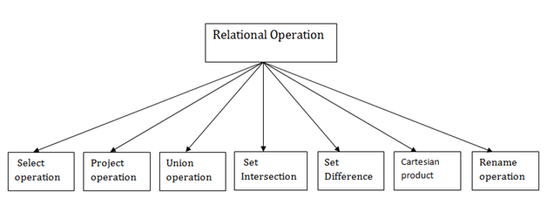
Relational Algebra
Relational algebra is a procedural query language. It gives a step-by-step process to obtain the result of the query. It uses operators to perform queries.
Types of Relational operation

Slide 23
1. Select Operation:
The select operation selects tuples that satisfy a given predicate.
It is denoted by sigma (σ).
Notation: σ p(r)
Where:
σ is used for selection prediction
r is used for relation
p is used as a propositional logic formula which may use connectors like: AND OR and NOT. These relational can use as relational operators like =, ≠, ≥, <, >, ≤.

Slide 24
For example: LOAN Relation
BRANCH_NAME | LOAN_NO | AMOUNT
Downtown | L-17 | 1000
Redwood | L-23 | 2000
Perryride | L-15 | 1500
Downtown | L-14 | 1500
Mianus | L-13 | 500
Roundhill | L-11 | 900
Perryride | L-16 | 1300

Slide 25
Input:
σ BRANCH_NAME="perryride" (LOAN)
Output:
BRANCH_NAME | LOAN_NO | AMOUNT
Perryride | L-15 | 1500
Perryride | L-16 | 1300

Slide 26
2. Project Operation:
This operation shows the list of those attributes that we wish to appear in the result. Rest of the attributes are eliminated from the table.
It is denoted by ∏.
Notation: ∏ A1, A2, An (r)
Where: A1, A2, A3 is used as an attribute name of relation r.

Slide 27
Example: CUSTOMER RELATION
NAME | STREET | CITY
Jones | Main | Harrison
Smith | North | Rye
Hays | Main | Harrison
Curry | North | Rye
Johnson | Alma | Brooklyn
Brooks | Senator | Brooklyn

Slide 28
Input:
∏ NAME, CITY (CUSTOMER)
Output:
NAME | CITY
Jones | Harrison
Smith | Rye
Hays | Harrison
Curry | Rye
Johnson | Brooklyn
Brooks | Brooklyn

Slide 29
Suppose there are two tuples R and S. The union operation contains all the tuples that are either in R or S or both in R & S.
It eliminates the duplicate tuples. It is denoted by ∪.
Notation: R ∪ S
A union operation must hold the following condition:
R and S must have the attribute of the same number.
Duplicate tuples are eliminated automatically.
3. Union Operation:

Slide 30
Example:
DEPOSITOR RELATION
CUSTOMER_NAME | ACCOUNT_NO
Johnson | A-101
Smith | A-121
Mayes | A-321
Turner | A-176
Johnson | A-273
Jones | A-472
Lindsay | A-284

Slide 31
BORROW RELATION
CUSTOMER_NAME | LOAN_NO
Jones | L-17
Smith | L-23
Hayes | L-15
Jackson | L-14
Curry | L-93
Smith | L-11
Williams | L-17

Slide 32
Input:
∏ CUSTOMER_NAME (BORROW) ∪ ∏ CUSTOMER_NAME (DEPOSITOR)
Output:
CUSTOMER_NAME
Johnson
Smith
Hayes
Turner
Jones
Lindsay
Jackson
Curry
Williams
Mayes

Slide 33
4. Set Intersection:
Suppose there are two tuples R and S. The set intersection operation contains all tuples that are in both R & S.
It is denoted by intersection ∩.
Notation: R ∩ S
Example: Using the above DEPOSITOR table and BORROW table
Input:
∏ CUSTOMER_NAME (BORROW) ∩ ∏ CUSTOMER_NAME (DEPOSITOR)

Slide 34
Output:
CUSTOMER_NAME
Smith
Jones

Slide 35
5. Set Difference:
Suppose there are two tuples R and S. The set intersection operation contains all tuples that are in R but not in S.
It is denoted by intersection minus (-).
Notation: R - S
Example: Using the above DEPOSITOR table and BORROW table
Input:
∏ CUSTOMER_NAME (BORROW) - ∏ CUSTOMER_NAME (DEPOSITOR)

Slide 36
Output:
CUSTOMER_NAME
Jackson
Hayes
Willians
Curry

Slide 37
6. Cartesian product
EMP_ID | EMP_NAME | EMP_DEPT
1 | Smith | A
2 | Harry | C
3 | John | B
The Cartesian product is used to combine each row in one table with each row in the other table. It is also known as a cross product.
It is denoted by X.
Notation: E X D
Example: EMPLOYEE Table

Slide 38
DEPARTMENT
DEPT_NO | DEPT_NAME
A | Marketing
B | Sales
C | Legal
Example: Department Table

Slide 39
Input: EMPLOYEE X DEPARTMENT
EMP_ID | EMP_NAME | EMP_DEPT | DEPT_NO | DEPT_NAME
1 | Smith | A | A | Marketing
1 | Smith | A | B | Sales
1 | Smith | A | C | Legal
2 | Harry | C | A | Marketing
2 | Harry | C | B | Sales
2 | Harry | C | C | Legal
3 | John | B | A | Marketing
3 | John | B | B | Sales
3 | John | B | C | Legal
Output:

Slide 40

7. Rename Operation:
The rename operation is used to rename the output relation. It is denoted by rho (ρ).
Example: We can use the rename operator to rename STUDENT relation to STUDENT1.
ρ(STUDENT1, STUDENT)

Slide 41
Join Operations:
A Join operation combines related tuples from different relations, if and only if a given join condition is satisfied. It is denoted by ⋈.
Example: EMPLOYEE
Example: SALARY
EMP_CODE | EMP_NAME
101 | Stephan
102 | Jack
103 | Harry
EMP_CODE | SALARY
101 | 50000
102 | 30000
103 | 25000

Slide 42
Operation:
(EMPLOYEE ⋈ SALARY)
Result:
EMP_CODE | EMP_NAME | SALARY
101 | Stephan | 50000
102 | Jack | 30000
103 | Harry | 25000

Slide 43
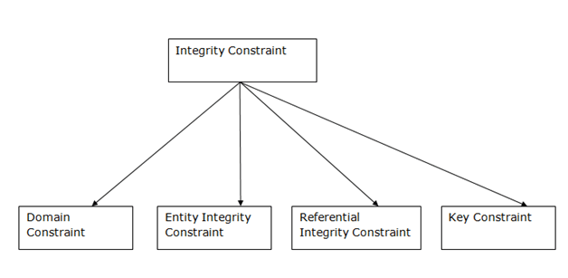
Integrity Constraints
Integrity constraints are a set of rules. It is used to maintain the quality of information.
Integrity constraints ensure that the data insertion, updating, and other processes have to be performed in such a way that data integrity is not affected.
Thus, integrity constraint is used to guard against accidental damage to the database.
Types of Integrity Constraint

Slide 44
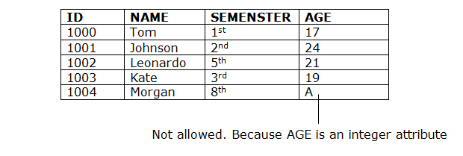
Domain constraints
Domain constraints can be defined as the definition of a valid set of values for an attribute.
The data type of domain includes string, character, integer, time, date, currency, etc. The value of the attribute must be available in the corresponding domain.
Example:

Slide 45
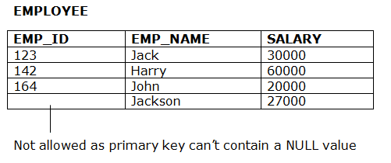
Entity integrity constraints
The entity integrity constraint states that primary key value can't be null.
This is because the primary key value is used to identify individual rows in relation and if the primary key has a null value, then we can't identify those rows.
A table can contain a null value other than the primary key field.
Example:

Slide 46
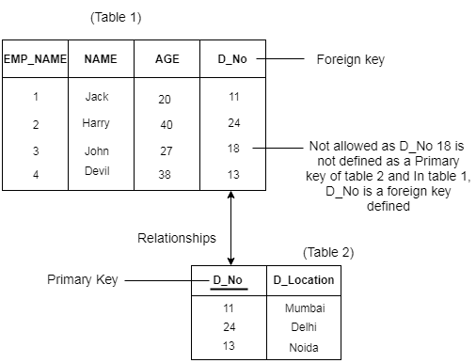
Referential Integrity Constraints
A referential integrity constraint is specified between two tables.
In the Referential integrity constraints, if a foreign key in Table 1 refers to the Primary Key of Table 2, then every value of the Foreign Key in Table 1 must be null or be available in Table 2.
Example:

Slide 47
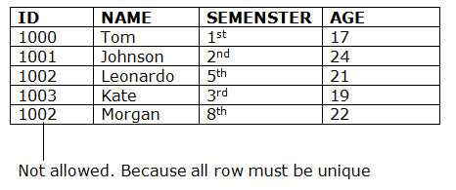
Key constraints
Keys are the entity set that is used to identify an entity within its entity set uniquely.
An entity set can have multiple keys, but out of which one key will be the primary key. A primary key can contain a unique and not null value in the relational table.
Example:

Slide 48
Session 2: Introduction to SQL

Slide 49
What is SQL?
SQL is a short-form of the structured query language, and it is pronounced as S-Q-L or sometimes as See-Quell.
This database language is mainly designed for maintaining the data in relational database management systems. It is a special tool used by data professionals for handling structured data (data which is stored in the form of tables). It is also designed for stream processing in RDSMS.
You can easily create and manipulate the database, access and modify the table rows and columns, etc. This query language became the standard of ANSI in the year of 1986 and ISO in the year of 1987.
If you want to get a job in the field of data science, then it is the most important query language to learn. Big enterprises like Facebook, Instagram, and LinkedIn, use SQL for storing the data in the back-end.

Slide 50

Why SQL?
Nowadays, SQL is widely used in data science and analytics. Following are the reasons which explain why it is widely used:
The basic use of SQL for data professionals and SQL users is to insert, update, and delete the data from the relational database.
SQL allows the data professionals and users to retrieve the data from the relational database management systems.
It also helps them to describe the structured data.
It allows SQL users to create, drop, and manipulate the database and its tables.
It also helps in creating the view, stored procedure, and functions in the relational database.
It allows you to define the data and modify that stored data in the relational database.
It also allows SQL users to set the permissions or constraints on table columns, views, and stored procedures.

Slide 51
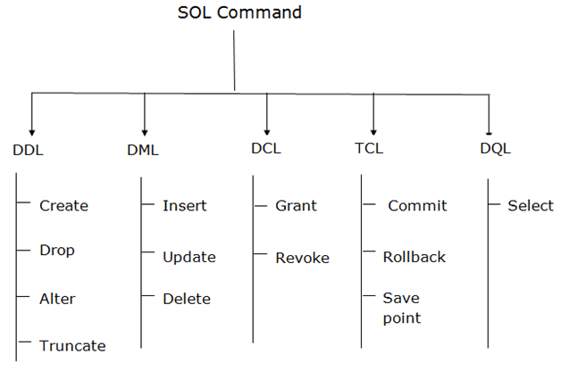
Types of SQL Command
There are five types of SQL commands: DDL, DML, DCL, TCL, and DQL.

Slide 52
Some SQL Commands
CREATE Command
This command helps in creating the new database, new table, table view, and other objects of the database.
UPDATE Command
This command helps in updating or changing the stored data in the database.
DELETE Command
This command helps in removing or erasing the saved records from the database tables. It erases single or multiple tuples from the tables of the database.
SELECT Command
This command helps in accessing the single or multiple rows from one or multiple tables of the database. We can also use this command with the WHERE clause.
DROP Command
This command helps in deleting the entire table, table view, and other objects from the database.
INSERT Command
This command helps in inserting the data or records into the database tables. We can easily insert the records in single as well as multiple rows of the table.

Slide 53
SQL provides various advantages which make it more popular in the field of data science. It is a perfect query language which allows data professionals and users to communicate with the database. Following are the best advantages or benefits of Structured Query Language:
1. No programming needed
SQL does not require a large number of coding lines for managing the database systems. We can easily access and maintain the database by using simple SQL syntactical rules. These simple rules make the SQL user-friendly.
2. High-Speed Query Processing
A large amount of data is accessed quickly and efficiently from the database by using SQL queries. Insertion, deletion, and updation operations on data are also performed in less time.
3. Standardized Language
SQL follows the long-established standards of ISO and ANSI, which offer a uniform platform across the globe to all its users.
4. Portability
The structured query language can be easily used in desktop computers, laptops, tablets, and even smartphones. It can also be used with other applications according to the user's requirements.
5. Interactive language
We can easily learn and understand the SQL language. We can also use this language for communicating with the database because it is a simple query language. This language is also used for receiving the answers to complex queries in a few seconds.
6. More than one Data View
The SQL language also helps in making the multiple views of the database structure for the different database users.

Slide 54
With the advantages of SQL, it also has some disadvantages, which are as follows:
1. Cost
The operation cost of some SQL versions is high. That's why some programmers cannot use the Structured Query Language.
2. Interface is Complex
Another big disadvantage is that the interface of Structured query language is difficult, which makes it difficult for SQL users to use and manage it.
3. Partial Database control
The business rules are hidden. So, the data professionals and users who are using this query language cannot have full database control.

Slide 55
SQL Syntax
When you want to do some operations on the data in the database, then you must have to write the query in the predefined syntax of SQL.
The syntax of the structured query language is a unique set of rules and guidelines, which is not case-sensitive. Its Syntax is defined and maintained by the ISO and ANSI standards.
Following are some most important points about the SQL syntax which are to remember:
You can write the keywords of SQL in both uppercase and lowercase, but writing the SQL keywords in uppercase improves the readability of the SQL query.
SQL statements or syntax are dependent on text lines. We can place a single SQL statement on one or multiple text lines.
You can perform most of the action in a database with SQL statements.
SQL syntax depends on relational algebra and tuple relational calculus.

Slide 56
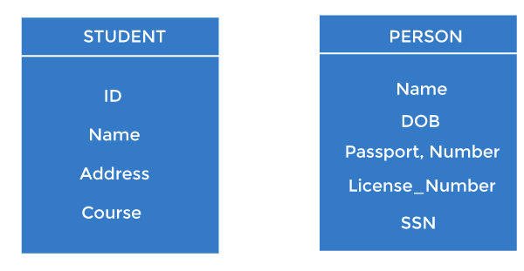
SQL Keys
Keys play an important role in the relational database.
It is used to uniquely identify any record or row of data from the table. It is also used to establish and identify relationships between tables.
For example, ID is used as a key in the Student table because it is unique for each student. In the PERSON table, passport_number, license_number, SSN are keys since they are unique for each person.

Slide 57
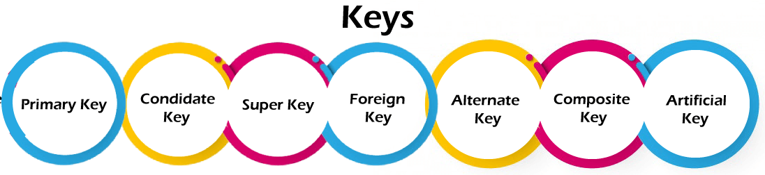
Types of Keys:

Slide 58
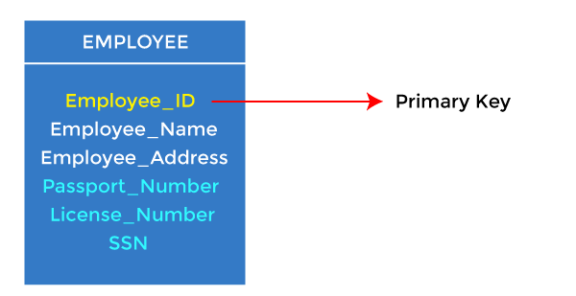
Primary Key
It is the first key used to identify one and only one instance of an entity uniquely. An entity can contain multiple keys, as we saw in the PERSON table. The key which is most suitable from those lists becomes a primary key.
In the EMPLOYEE table, ID can be the primary key since it is unique for each employee. In the EMPLOYEE table, we can even select License_Number and Passport_Number as primary keys since they are also unique.
For each entity, the primary key selection is based on requirements and developers.

Slide 59
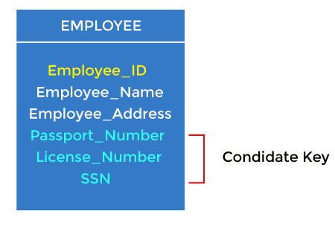
Candidate key
A candidate key is an attribute or set of attributes that can uniquely identify a tuple.
Except for the primary key, the remaining attributes are considered a candidate key. The candidate keys are as strong as the primary key.
For example: In the EMPLOYEE table, id is best suited for the primary key. The rest of the attributes, like SSN, Passport_Number, License_Number, etc., are considered a candidate key.

Slide 60
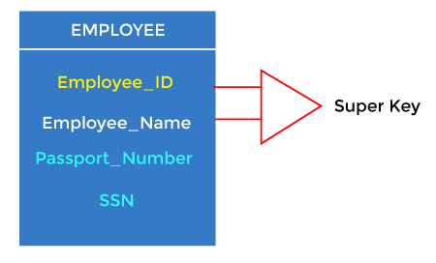
Super Key
Super key is an attribute set that can uniquely identify a tuple. A super key is a superset of a candidate key.
For example: In the above EMPLOYEE table, for(EMPLOEE_ID, EMPLOYEE_NAME), the name of two employees can be the same, but their EMPLYEE_ID can't be the same. Hence, this combination can also be a key.
The super key would be EMPLOYEE-ID (EMPLOYEE_ID, EMPLOYEE-NAME), etc.

Slide 61
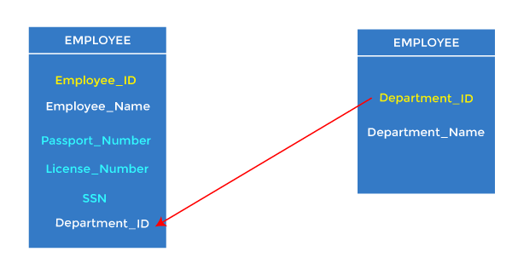
Foreign key
Foreign keys are the column of the table used to point to the primary key of another table.
Every employee works in a specific department in a company, and employee and department are two different entities. So we can't store the department's information in the employee table. That's why we link these two tables through the primary key of one table.
We add the primary key of the DEPARTMENT table, Department_Id, as a new attribute in the EMPLOYEE table.
In the EMPLOYEE table, Department_Id is the foreign key, and both the tables are related.

Slide 62
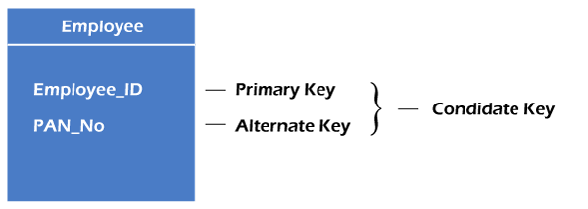
Alternate key
There may be one or more attributes or a combination of attributes that uniquely identify each tuple in a relation. These attributes or combinations of the attributes are called the candidate keys. One key is chosen as the primary key from these candidate keys, and the remaining candidate key, if it exists, is termed the alternate key. In other words, the total number of the alternate keys is the total number of candidate keys minus the primary key. The alternate key may or may not exist. If there is only one candidate key in a relation, it does not have an alternate key.
For example, employee relation has two attributes, Employee_Id and PAN_No, that act as candidate keys. In this relation, Employee_Id is chosen as the primary key, so the other candidate key, PAN_No, acts as the Alternate key.

Slide 63
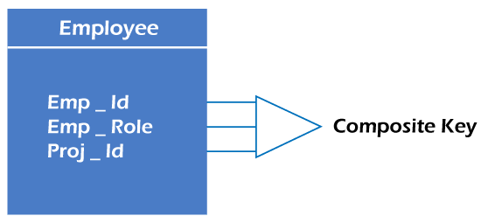
Composite key
Whenever a primary key consists of more than one attribute, it is known as a composite key. This key is also known as Concatenated Key.
For example, in employee relations, we assume that an employee may be assigned multiple roles, and an employee may work on multiple projects simultaneously. So the primary key will be composed of all three attributes, namely Emp_ID, Emp_role, and Proj_ID in combination. So these attributes act as a composite key since the primary key comprises more than one attribute.

Slide 64
Most Important SQL Commands and Statements
Select Statement
Update Statement
Delete Statement
Create Table Statement
Alter Table Statement
Drop Table Statement
Create Database Statement
Drop Database Statement
Insert Into Statement
Truncate Table Statement
Describe Statement
Distinct Clause
Commit Statement
Rollback Statement
Create Index Statement
Drop Index Statement
Use Statement

Slide 65
Session 3: MySQL CRUD Operations

Slide 66
CREATE DATABASE Statement
This SQL statement creates the new database in the database management system.
Syntax of CREATE DATABASE Statement:
CREATE DATABASE database_name;
Example of CREATE DATABASE Statement:
CREATE DATABASE Company;
USE: This command is used to select a specific database to work with. For example:
USE database_name;

Slide 67
DROP DATABASE Statement
This SQL statement deletes the existing database with all the data tables and views from the database management system.
Syntax of DROP DATABASE Statement:
DROP DATABASE database_name;
Example of DROP DATABASE Statement:
DROP DATABASE Company;
The above example deletes the company database from the system.

Slide 68
CREATE TABLE Statement
CREATE TABLE table_name
(
column_name1 data_type [column1 constraint(s)],
column_name2 data_type [column2 constraint(s)],
.....
.....,
column_nameN data_type [columnN constraint(s)],
PRIMARY KEY(one or more col)
);
CREATE TABLE Employee_details(
Emp_Id NUMBER(4) NOT NULL,
First_name VARCHAR(30),
Last_name VARCHAR(30),
Salary Money,
City VARCHAR(30),
PRIMARY KEY (Emp_Id)
);
This example creates the table Employee_details with five columns or fields in the SQL database. The fields in the table are Emp_Id, First_Name, Last_Name, Salary, and City. The Emp_Id column in the table acts as a primary key, which means that the Emp_Id column cannot contain duplicate values and null values.

Slide 69
DESCRIBE Statement
This SQL statement tells something about the specified table or view in the query.
Syntax of DESCRIBE Statement:
DESCRIBE table_name | view_name;
Example of DESCRIBE Statement:
DESCRIBE Employee_details;
This example explains the structure and other details about the Employee_details table.

Slide 70
INSERT INTO Statement
This SQL statement inserts the data or records in the existing table of the SQL database. This statement can easily insert single and multiple records in a single query statement.
Syntax of insert a single record:
INSERT INTO table_name
(
column_name1,
column_name2, .…,
column_nameN
)
VALUES
(value_1,
value_2, ..…,
value_N
);

Slide 71
INSERT INTO Employee_details
(
Emp_ID,
First_name,
Last_name,
Salary,
City
)
VALUES
(101,
Akhil,
Sharma,
40000,
Bangalore
);
This example inserts 101 in the first column, Akhil in the second column, Sharma in the third column, 40000 in the fourth column, and Bangalore in the last column of the table Employee_details.

Slide 72
Syntax of inserting a multiple records in a single query
INSERT INTO table_name
( column_name1, column_name2, .…, column_nameN)
VALUES (value_1, value_2, ..…, value_N), (value_1, value_2, ..…, value_N),….;
Example of inserting multiple records in a single query:
INSERT INTO Employee_details
( Emp_ID, First_name, Last_name, Salary, City )
VALUES (101, Amit, Gupta, 50000, Mumbai), (101, John, Aggarwal, 45000, Calcutta), (101, Sidhu, Arora, 55000, Mumbai);
This example inserts the records of three employees in the Employee_details table in the single query statement.

Slide 73
DELETE Statement
This SQL statement deletes the stored data from the SQL database.
Syntax of DELETE Statement:
DELETE FROM table_name
[ WHERE CONDITION ];
Example of DELETE Statement:
DELETE FROM Employee_details
WHERE First_Name = 'Sumit';
This example deletes the record of those employees from the Employee_details table whose First_Name is Sumit in the table.

Slide 74
DROP TABLE Statement
This SQL statement deletes or removes the table and the structure, views, permissions, and triggers associated with that table.
Syntax of DROP TABLE Statement:
DROP TABLE [ IF EXISTS ]
table_name1, table_name2, ……, table_nameN;
The above syntax of the drop statement deletes specified tables completely if they exist in the database.
Example of DROP TABLE Statement:
DROP TABLE Employee_details;
This example drops the Employee_details table if it exists in the SQL database. This removes the complete information if available in the table.

Slide 75
TRUNCATE TABLE Statement
This SQL statement deletes all the stored records from the table of the SQL database.
Syntax of TRUNCATE TABLE Statement:
TRUNCATE TABLE table_name;
Example of TRUNCATE TABLE Statement:
TRUNCATE TABLE Employee_details;
This example deletes the record of all employees from the Employee_details table of the database.

Slide 76
SQL statements tell the database what operation you want to perform on the structured data and what information you would like to access from the database.
The statements of SQL are very simple and easy to use and understand. They are like plain English but with a particular syntax.
Simple Example of SQL statement:
SELECT "column_name" FROM "table_name";
Each SQL statement begins with any of the SQL keywords and ends with the semicolon (;). The semicolon is used in the SQL for separating the multiple Sql statements which are going to execute in the same call. In this SQL tutorial, we will use the semicolon (;) at the end of each SQL query or statement.

Slide 77
SELECT Statement
This SQL statement reads the data from the SQL database and shows it as the output to the database user.
Syntax of SELECT Statement:
SELECT column_name1, column_name2, .…, column_nameN
[ FROM table_name ]
[ WHERE condition ]
[ ORDER BY order_column_name1 [ ASC | DESC ], .... ];
Example of SELECT Statement:
SELECT Emp_ID, First_Name, Last_Name, Salary, City
FROM Employee_details
WHERE Salary = 100000
ORDER BY Last_Name
This example shows the Emp_ID, First_Name, Last_Name, Salary, and City of those employees from the Employee_details table whose Salary is 100000. The output shows all the specified details according to the ascending alphabetical order of Last_Name.

Slide 78
UPDATE Statement
This SQL statement changes or modifies the stored data in the SQL database.
Syntax of UPDATE Statement:
UPDATE table_name
SET column_name1 = new_value_1, column_name2 = new_value_2, ...., column_nameN = new_value_N
[ WHERE CONDITION ];
Example of UPDATE Statement:
UPDATE Employee_details
SET Salary = 100000
WHERE Emp_ID = 10;
This example changes the Salary of those employees of the Employee_details table whose Emp_ID is 10 in the table.

Slide 79
ALTER TABLE Statement
This SQL statement adds, deletes, and modifies the columns of the table in the SQL database.
Syntax of ALTER TABLE Statement:
ALTER TABLE table_name ADD column_name datatype[(size)];
The above SQL alter statement adds the column with its datatype in the existing database table.
ALTER TABLE table_name MODIFY column_name column_datatype[(size)];
The above 'SQL alter statement' renames the old column name to the new column name of the existing database table.
ALTER TABLE table_name DROP COLUMN column_name;
The above SQL alter statement deletes the column of the existing database table.

Slide 80
ALTER TABLE Statement
Example of ALTER TABLE Statement:
ALTER TABLE Employee_details
ADD Designation VARCHAR(18);
This example adds the new field whose name is Designation with size 18 in the Employee_details table of the SQL database.

Slide 81
DISTINCT Clause
This SQL statement shows the distinct values from the specified columns of the database table. This statement is used with the SELECT keyword.
Syntax of DISTINCT Clause:
SELECT DISTINCT column_name1, column_name2, ...
FROM table_name;
Example of DISTINCT Clause:
SELECT DISTINCT City, Salary
FROM Employee_details;
This example shows the distinct values of the City and Salary column from the Employee_details table.

Slide 82
COMMIT Statement
This SQL statement saves the changes permanently, which are done in the transaction of the SQL database.
Syntax of COMMIT Statement:
COMMIT
Example of COMMIT Statement:
DELETE FROM Employee_details
WHERE salary = 30000;
COMMIT;
This example deletes the records of those employees whose Salary is 30000 and then saves the changes permanently in the database.

Slide 83
ROLLBACK Statement
This SQL statement undo the transactions and operations which are not yet saved to the SQL database.
Syntax of ROLLBACK Statement:
ROLLBACK
Example of ROLLBACK Statement:
DELETE FROM Employee_details
WHERE City = Mumbai;
ROLLBACK;
This example deletes the records of those employees whose City is Mumbai and then undo the changes in the database.

Slide 84
CREATE INDEX Statement
This SQL statement creates the new index in the SQL database table.
Syntax of CREATE INDEX Statement:
CREATE INDEX index_name
ON table_name ( column_name1, column_name2, …, column_nameN );
Example of CREATE INDEX Statement:
CREATE INDEX idx_First_Name
ON employee_details (First_Name);
This example creates an index idx_First_Name on the First_Name column of the Employee_details table.

Slide 85
DROP INDEX Statement
This SQL statement deletes the existing index of the SQL database table.
Syntax of DROP INDEX Statement:
DROP INDEX index_name;
Example of DROP INDEX Statement:
DROP INDEX idx_First_Name;
This example deletes the index idx_First_Name from the SQL database.

Slide 86
SQL Data Types
Data types are used to represent the nature of the data that can be stored in the database table. For example, in a particular column of a table, if we want to store a string type of data then we will have to declare a string data type of this column.
Data types mainly classified into three categories for every database.
String Data types
Numeric Data types
Date and time Data types

Slide 87
Data Types in MySQL
CHAR(Size) | It is used to specify a fixed length string that can contain numbers, letters, and special characters. Its size can be 0 to 255 characters. Default is 1.
VARCHAR(Size) | It is used to specify a variable length string that can contain numbers, letters, and special characters. Its size can be from 0 to 65535 characters.
BINARY(Size) | It is equal to CHAR() but stores binary byte strings. Its size parameter specifies the column length in the bytes. Default is 1.
VARBINARY(Size) | It is equal to VARCHAR() but stores binary byte strings. Its size parameter specifies the maximum column length in bytes.
TEXT(Size) | It holds a string that can contain a maximum length of 255 characters.
TINYTEXT | It holds a string with a maximum length of 255 characters.
MEDIUMTEXT | It holds a string with a maximum length of 16,777,215.
LONGTEXT | It holds a string with a maximum length of 4,294,967,295 characters.
ENUM(val1, val2, val3,...) | It is used when a string object having only one value, chosen from a list of possible values. It contains 65535 values in an ENUM list. If you insert a value that is not in the list, a blank value will be inserted.
SET( val1,val2,val3,....) | It is used to specify a string that can have 0 or more values, chosen from a list of possible values. You can list up to 64 values at one time in a SET list.
BLOB(size) | It is used for BLOBs (Binary Large Objects). It can hold up to 65,535 bytes.
A list of data types used in MySQL database. This is based on MySQL 8.0.

Slide 88
MySQL Numeric Data Types
BIT(Size) | It is used for a bit-value type. The number of bits per value is specified in size. Its size can be 1 to 64. The default value is 1.
INT(size) | It is used for the integer value. Its signed range varies from -2147483648 to 2147483647 and unsigned range varies from 0 to 4294967295. The size parameter specifies the max display width that is 255.
INTEGER(size) | It is equal to INT(size).
FLOAT(size, d) | It is used to specify a floating point number. Its size parameter specifies the total number of digits. The number of digits after the decimal point is specified by d parameter.
FLOAT(p) | It is used to specify a floating point number. MySQL used p parameter to determine whether to use FLOAT or DOUBLE. If p is between 0 to24, the data type becomes FLOAT (). If p is from 25 to 53, the data type becomes DOUBLE().
DOUBLE(size, d) | It is a normal size floating point number. Its size parameter specifies the total number of digits. The number of digits after the decimal is specified by d parameter.
DECIMAL(size, d) | It is used to specify a fixed point number. Its size parameter specifies the total number of digits. The number of digits after the decimal parameter is specified by d parameter. The maximum value for the size is 65, and the default value is 10. The maximum value for d is 30, and the default value is 0.
DEC(size, d) | It is equal to DECIMAL(size, d).
BOOL | It is used to specify Boolean values true and false. Zero is considered as false, and nonzero values are considered as true.
A list of data types used in MySQL database. This is based on MySQL 8.0

Slide 89
MySQL Date and Time Data Types
DATE | It is used to specify date format YYYY-MM-DD. Its supported range is from '1000-01-01' to '9999-12-31'.
DATETIME(fsp) | It is used to specify date and time combination. Its format is YYYY-MM-DD hh:mm:ss. Its supported range is from '1000-01-01 00:00:00' to 9999-12-31 23:59:59'.
TIMESTAMP(fsp) | It is used to specify the timestamp. Its value is stored as the number of seconds since the Unix epoch('1970-01-01 00:00:00' UTC). Its format is YYYY-MM-DD hh:mm:ss. Its supported range is from '1970-01-01 00:00:01' UTC to '2038-01-09 03:14:07' UTC.
TIME(fsp) | It is used to specify the time format. Its format is hh:mm:ss. Its supported range is from '-838:59:59' to '838:59:59'
YEAR | It is used to specify a year in four-digit format. Values allowed in four digit format from 1901 to 2155, and 0000.
A list of data types used in MySQL database.

Slide 90
Session 4: SQL Joins and Triggers

Slide 91
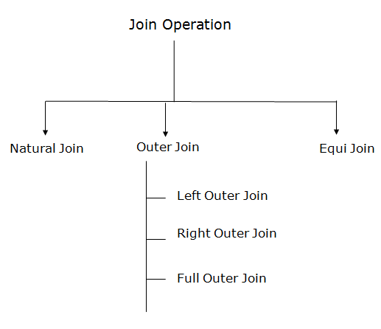
Types of Join operations:

Slide 92
1. Natural Join:
A natural join is the set of tuples of all combinations in R and S that are equal on their common attribute names.
It is denoted by ⋈.
Example: Let's use the above EMPLOYEE table and SALARY table:
Input:
∏EMP_NAME, SALARY (EMPLOYEE ⋈ SALARY)
EMP_NAME | SALARY
Stephan | 50000
Jack | 30000
Harry | 25000

Slide 93
2. Outer Join:
The outer join operation is an extension of the join operation. It is used to deal with missing information.
Example: EMPLOYEE
FACT_WORKERS
EMP_NAME | STREET | CITY
Ram | Civil line | Mumbai
Shyam | Park street | Kolkata
Ravi | M.G. Street | Delhi
Hari | Nehru nagar | Hyderabad
EMP_NAME | BRANCH | SALARY
Ram | Infosys | 10000
Shyam | Wipro | 20000
Kuber | HCL | 30000
Hari | TCS | 50000

Slide 94
Input:
(EMPLOYEE ⋈ FACT_WORKERS)
Output:
EMP_NAME | STREET | CITY | BRANCH | SALARY
Ram | Civil line | Mumbai | Infosys | 10000
Shyam | Park street | Kolkata | Wipro | 20000
Hari | Nehru nagar | Hyderabad | TCS | 50000

Slide 95
An outer join is basically of three types:
Left outer join, b. Right outer join, c. Full outer join
Left outer join:
Left outer join contains the set of tuples of all combinations in R and S that are equal on their common attribute names.
In the left outer join, tuples in R have no matching tuples in S.
It is denoted by ⟕.

Slide 96
Example: Using the above EMPLOYEE table and FACT_WORKERS table
EMP_NAME | STREET | CITY | BRANCH | SALARY
Ram | Civil line | Mumbai | Infosys | 10000
Shyam | Park street | Kolkata | Wipro | 20000
Hari | Nehru street | Hyderabad | TCS | 50000
Ravi | M.G. Street | Delhi | NULL | NULL
Input: EMPLOYEE ⟕ FACT_WORKERS

Slide 97
Right outer join:
Output:
EMP_NAME | BRANCH | SALARY | STREET | CITY
Ram | Infosys | 10000 | Civil line | Mumbai
Shyam | Wipro | 20000 | Park street | Kolkata
Hari | TCS | 50000 | Nehru street | Hyderabad
Kuber | HCL | 30000 | NULL | NULL
Right outer join contains the set of tuples of all combinations in R and S that are equal on their common attribute names.
In right outer join, tuples in S have no matching tuples in R.
It is denoted by ⟖.
Example: Using the above EMPLOYEE table and FACT_WORKERS Relation
Input: EMPLOYEE ⟖ FACT_WORKERS

Slide 98
Full outer join:
Output:
EMP_NAME | STREET | CITY | BRANCH | SALARY
Ram | Civil line | Mumbai | Infosys | 10000
Shyam | Park street | Kolkata | Wipro | 20000
Hari | Nehru street | Hyderabad | TCS | 50000
Ravi | M.G. Street | Delhi | NULL | NULL
Kuber | NULL | NULL | HCL | 30000
Full outer join is like a left or right join except that it contains all rows from both tables.
In full outer join, tuples in R that have no matching tuples in S and tuples in S that have no matching tuples in R in their common attribute name.
It is denoted by ⟗.
Example: Using the above EMPLOYEE table and FACT_WORKERS table
Input: EMPLOYEE ⟗ FACT_WORKERS

Slide 99
Equi join:
It is also known as an inner join. It is the most common join. It is based on matched data as per the equality condition. The equi join uses the comparison operator(=).
Example:
CUSTOMER RELATION
PRODUCT
CLASS_ID | NAME
1 | John
2 | Harry
3 | Jackson
PRODUCT_ID | CITY
1 | Delhi
2 | Mumbai
3 | Noida

Slide 100
Input: CUSTOMER ⋈ PRODUCT
Output:
CLASS_ID | NAME | PRODUCT_ID | CITY
1 | John | 1 | Delhi
2 | Harry | 2 | Mumbai
3 | Harry | 3 | Noida

Slide 101
MySQL Triggers
In MySQL, a trigger is a stored program invoked automatically in response to an event such as insert, update, or delete that occurs in the associated table.
For example, you can define a trigger that is invoked automatically before a new row is inserted into a table.
MySQL supports triggers that are invoked in response to the INSERT, UPDATE or DELETE event.

Slide 102
MySQL Triggers
The SQL standard defines two types of triggers: row-level triggers and statement-level triggers.
A row-level trigger is activated for each row that is inserted, updated, or deleted. For example, if a table has 100 rows inserted, updated, or deleted, the trigger is automatically invoked 100 times for the 100 rows affected.
A statement-level trigger is executed once for each transaction regardless of how many rows are inserted, updated, or deleted.
MySQL supports only row-level triggers. It doesn’t support statement-level triggers.

Slide 103
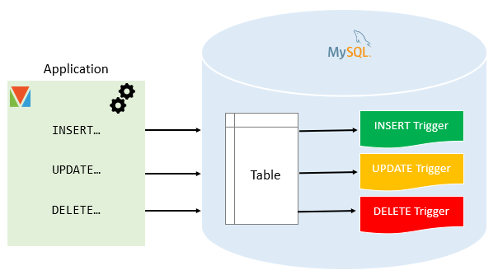
MySQL Triggers

Slide 104
Advantages of Triggers
Triggers provide another way to check the integrity of data.
Triggers handle errors from the database layer.
Triggers give an alternative way to run scheduled tasks. By using triggers, you don’t have to wait for the scheduled events to run because the triggers are invoked automatically before or after a change is made to the data in a table.
Triggers can be useful for auditing the data changes in tables.

Slide 105
Disadvantages of Triggers
Triggers can only provide extended validations, not all validations. For simple validations, you can use the NOT NULL, UNIQUE, CHECK and FOREIGN KEY constraints.
Triggers can be difficult to troubleshoot because they execute automatically in the database, which may not be visible to the client applications.
Triggers may increase the overhead of the MySQL server.

Slide 106
Managing MySQL triggers
Create triggers – describe steps of how to create a trigger in MySQL.
Drop triggers – show you how to drop a trigger.
Create a BEFORE INSERT trigger – show you how to create a BEFORE INSERT trigger to maintain a summary table from another table.
Create an AFTER INSERT trigger – describe how to create an AFTER INSERT trigger to insert data into a table after inserting data into another table.
Create a BEFORE UPDATE trigger – learn how to create a BEFORE UPDATE trigger that validates data before it is updated to the table.
Create an AFTER UPDATE trigger – show you how to create an

Slide 107
Managing MySQL triggers
AFTER UPDATE trigger to log the changes of data in a table.
Create a BEFORE DELETE trigger – show how to create a BEFORE DELETE trigger.
Create an AFTER-DELETE trigger – describe how to create an AFTER-DELETE trigger.
Create multiple triggers for a table that has the same trigger event and time – MySQL 8.0 allows you to define multiple triggers for a table that has the same trigger event and time.
Show triggers – list triggers in a database, table by specific patterns.

Slide 108
MySQL Before Insert trigger
1. MySQL Before Insert Trigger
In this article, we are going to learn how to create the first trigger in MySQL. We can create a new trigger in MySQL by using the CREATE TRIGGER statement. It is to ensure that we have trigger privileges while using the CREATE TRIGGER command. The following is the basic syntax to create a trigger:
1. CREATE TRIGGER trigger_name trigger_time trigger_event
2. ON table_name FOR EACH ROW
3. BEGIN
4. --variable declarations
5. --trigger code
6. END;

Slide 109
MySQL Before Insert trigger
1. MySQL Before Insert Trigger
In this article, we are going to learn how to create the first trigger in MySQL. We can create a new trigger in MySQL by using the CREATE TRIGGER statement. It is to ensure that we have trigger privileges while using the CREATE TRIGGER command. The following is the basic syntax to create a trigger:
1. CREATE TRIGGER trigger_name trigger_time trigger_event
2. ON table_name FOR EACH ROW
3. BEGIN
4. --variable declarations
5. --trigger code
6. END;

Slide 110
MySQL After Insert trigger
The following is the syntax to create an AFTER INSERT trigger in MySQL:
1. CREATE TRIGGER trigger_name
2. AFTER INSERT
3. ON table_name FOR EACH ROW
4. trigger_body ;
The AFTER INSERT trigger syntax parameter can be explained as below:
1. DELIMITER $$
2. CREATE TRIGGER trigger_name AFTER INSERT
3. ON table_name FOR EACH ROW
4. BEGIN
5. variable declarations
6. trigger code
7. END$$
8. DELIMITER ;

Slide 111
MySQL Before Delete trigger
The following is the syntax to create a BEFORE DELETE trigger in MySQL:
1. CREATE TRIGGER trigger_name
2. BEFORE DELETE
3. ON table_name FOR EACH ROW
Trigger_body ;
DELIMITER $$
CREATE TRIGGER trigger_name BEFORE DELETE
ON table_name FOR EACH ROW
BEGIN
variable declarations
trigger code
END$$
DELIMITER ;

Slide 112
MySQL After Delete trigger
The following is the syntax to create an AFTER DELETE trigger in MySQL:
1. CREATE TRIGGER trigger_name
2. AFTER DELETE
3. ON table_name FOR EACH ROW
4. Trigger_body ;
1. DELIMITER $$
2. CREATE TRIGGER trigger_name AFTER DELETE
3. ON table_name FOR EACH ROW
4. BEGIN
5. variable declarations
6. trigger code
7. END$$
8. DELIMITER ;

Slide 113
MySQL Before Update trigger
The following is the syntax to create a BEFORE UPDATE trigger in MySQL:
1. CREATE TRIGGER trigger_name
2. BEFORE UPDATE
3. ON table_name FOR EACH ROW
trigger_body ;
1. DELIMITER $$
2. CREATE TRIGGER trigger_name Before UPDATE
3. ON table_name FOR EACH ROW
4. BEGIN
5. variable declarations
6. trigger code
7. END$$
8. DELIMITER ;

Slide 114
MySQL After Update trigger
The following is the syntax to create an AFTER UPDATE trigger in MySQL:
1. CREATE TRIGGER trigger_name
2. AFTER UPDATE
3. ON table_name FOR EACH ROW
4. trigger_body ;
1. DELIMITER $$
2. CREATE TRIGGER trigger_name AFTER UPDATE
3. ON table_name FOR EACH ROW
4. BEGIN
5. variable declarations
6. trigger code
7. END$$
8. DELIMITER ;

Slide 115
Practice Problems for Participants
Practice problems for participants to enhance their MySQL database skills:
Creating a Table: Create a table named "students" with columns for student ID, name, age, and grade.
Inserting Data: Insert three records into the "students" table with different student details.
Retrieving Data: Write a query to retrieve all columns from the "students" table.
Filtering Data: Retrieve the names of students who are 18 years old.
Sorting Data: Retrieve all student records sorted by their grades in descending order.
Updating Data: Update the grade of a student named "Alice" to 'A+'.
Deleting Data: Delete the record of the student with the lowest grade.
Counting Rows: Count the total number of students in the table.
Finding Maximum and Minimum: Find the oldest and youngest students in the table.
Grouping Data: Group students by their grades and count the number of students in each grade.

Slide 116
Practice Problems for Participants
Joining Tables: Create a new table named "courses" with columns for course ID and course name. Then, insert some courses. Finally, write a query to retrieve all students along with the courses they are enrolled in.
Using Aliases: Write a query to retrieve the names and ages of students, displaying "Age" as "Student_Age".
Using Aggregate Functions: Calculate the average age of all students.
Limiting Results: Retrieve only the first 5 records from the "students" table.
Using Subqueries: Retrieve the names of students whose age is greater than the average age of all students.
Distinct Values: Retrieve all distinct grades present in the table.
Pattern Matching: Retrieve the names of students starting with the letter 'J'.
Combining Conditions: Retrieve the names of students who are either 18 years old or have a grade higher than 'B'.
Checking NULL Values: Retrieve the names of students whose age is not specified (NULL).

Slide 117
Practice Problems for Participants
Primary Key Constraint: Add a primary key constraint to the "student_id" column in the "students" table.
Unique Constraint: Ensure that the "email" column in the "students" table does not allow duplicate values.
Foreign Key Constraint: Create a foreign key constraint between the "course_id" column in the "courses" table and the "course_id" column in the "students" table.
Check Constraint: Add a check constraint to the "grade" column in the "students" table to ensure that grades are within the range of 'A' to 'F'.
Not Null Constraint: Ensure that the "name" column in the "students" table does not allow NULL values.
Audit Trigger: Create a trigger that logs any changes made to the "students" table, recording the old and new values along with the timestamp of the change.
Auto-Increment Trigger: Implement a trigger that automatically generates a unique student ID for new entries in the "students" table.
Deny Delete Trigger: Set up a trigger that prevents the deletion of any record from the "courses" table if there are students enrolled in that course.
Complex Calculations Trigger: Create a trigger that updates the "average_grade" column in the "courses" table whenever a student's grade is updated.

Slide 118
Thank you

